Slide 2
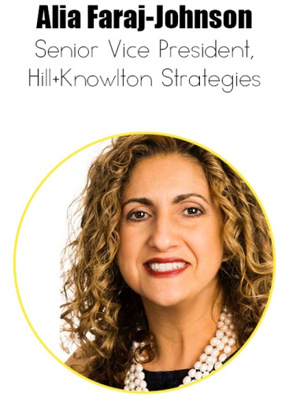
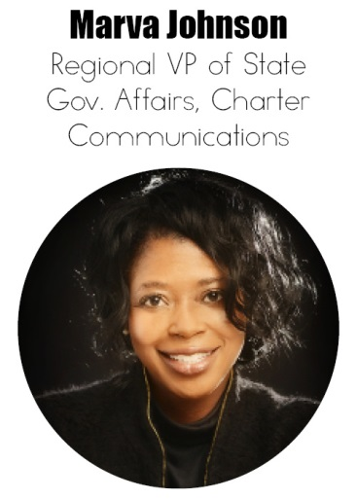
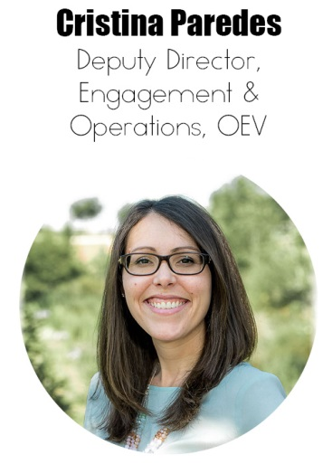
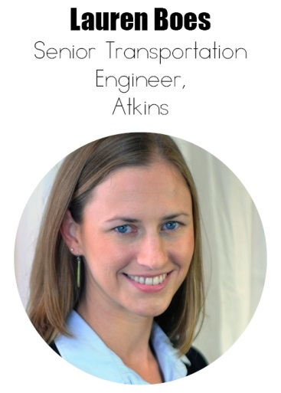
Innovation & Career Development Panel

Slide 3
Modern Women are More Educated than Previous Generations
What are your thoughts on how this will impact the business world going forward?

Slide 4
Who inspires you and why?

Slide 5
What resources do you take advantage of to advance your career?

Slide 6
Share a story of when you transitioned into a significantly different role or career path. How did this effect your professional development?

Slide 7
How are you participating in or leading innovation in your business model or professional life?

Slide 8
What are some ways you think women can help each other succeed professionally?
“When you've worked hard, and done well, and walked through that doorway of opportunity, you do not slam it shut behind you. You reach back.”
– Michelle Obama

Slide 9
What's one core message you received from your mentor(s) that truly stayed with you throughout your career?

Slide 10
What do Successful Women have in Common?
Which skills developed throughout your career do you believe are most instrumental to your success and where you are today?
They’re not afraid to take risks
They know that failure goes hand-in-hand with success
They seek guidance from a mentor
They are deeply passionate about what they do
They take time to relax every now and then
1
2
3
4
5

Slide 11
What's one of the toughest professional decisions you’ve had to make and how did it impact your life and career?

Slide 12
If you could only work on one project for a year to grow as a professional, what would it be and why?
“I wanted to sell a million records, and I sold a million records. I wanted to go platinum; I went platinum. I've been working nonstop since I was 15. I don't even know how to chill out.”
– Beyonce Knowles

Slide 13
What 3 pieces of advice would you give to college students entering the current job market?

Slide 14
What will be the biggest challenge for the generation of women behind you?

Slide 15
Audience Q&A

Slide 16
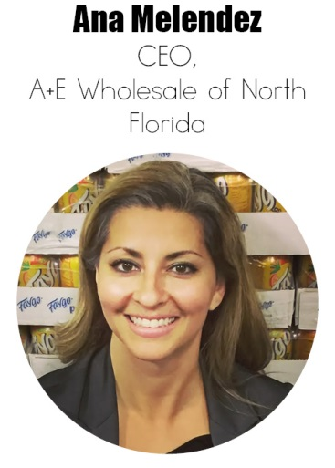
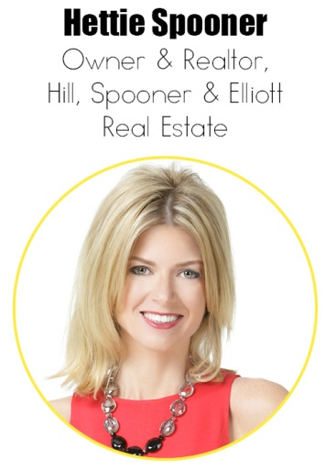
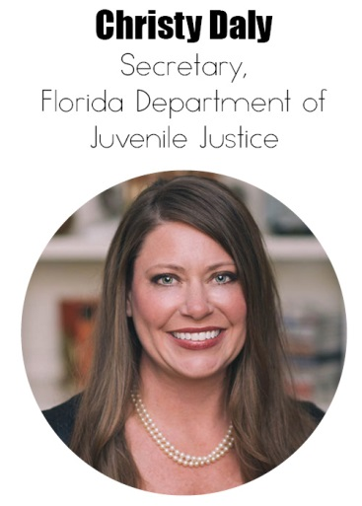
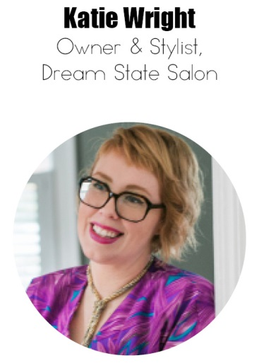
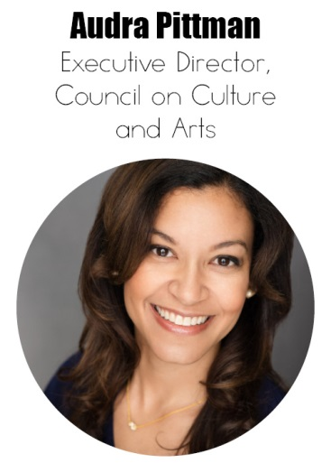
Leadership & Business Ownership Panel

Slide 17
Women-Owned Business Growth in FL
Florida is the fastest-growing state in the country for women-owned businesses, showing a 67% increase between 2007 and 2016.

Slide 18
What ignited the spark in you to start a new business venture or to make significant changes in an existing business? How did the idea for your business come about?

Slide 19
What is the key to making a lasting first impression on a new client or potential contact?

Slide 20
Do you believe government regulation helps or hinders your business? Do you have any examples to share?

Slide 21
What’s your definition of a leader?
“In the future, there will be no female leaders. There will just be leaders.”
― Sheryl Sandberg, COO of Facebook

Slide 22
What is one characteristic that you believe every leader should possess?

Slide 23
What do you think is the most significant barrier to female leadership?
How can we effectively break the mold that the above graph displays?

Slide 24
What advice would you give someone going into a leadership position for the first time?

Slide 25
How do you encourage creative thinking within your organization?
“Creativity is the DNA of innovation, the virus of evolution, the antidote to automation”
― Natasha Tsakos, Author

Slide 26
As an organization gets larger there can be a tendency for the “institution” to dampen the “inspiration.” How do you keep this from happening?

Slide 27
The Impact of Digital Fluency on American Women’s Careers
Digital Fluency is the aptitude to effectively and ethically interpret information, discover meaning, design content, construct knowledge, and communicate ideas in a digitally connected world.
Digital fluency acts as an accelerant at every stage of a woman’s career — a powerful one in both education and employment, and an increasingly important factor for advancing into the ranks of leadership.
The United States has the highest overall score for digital fluent women.

Slide 28
Can you explain the impact, if any, that social networking and Web 2.0 has made on your organization or your career development?

Slide 29
The 3 Actions and Attributes that Drive Fast-Track Women
Fast-track women typically reach manager level within five years and lead their peer group in terms of advancement in the workplace.

Slide 30
What are you doing to ensure you continue to grow and develop as a leader?

Slide 31
What are a few resources you would recommend to someone looking to gain insight into becoming a better leader?

Slide 32
Audience Q&A

